Slide 1
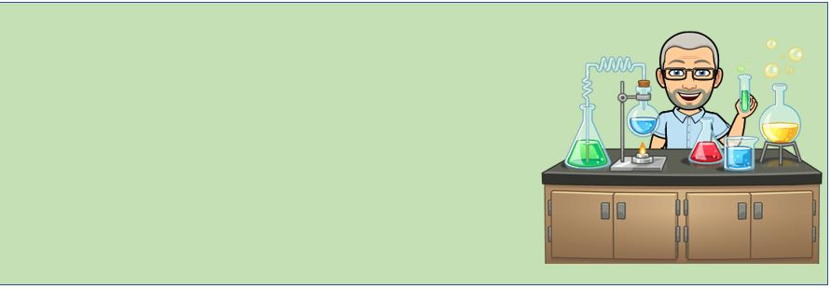
WELCOME TO
MR. NIEBOJESKI’S WONDERFUL WORLD OF SCIENCE!!

Slide 2
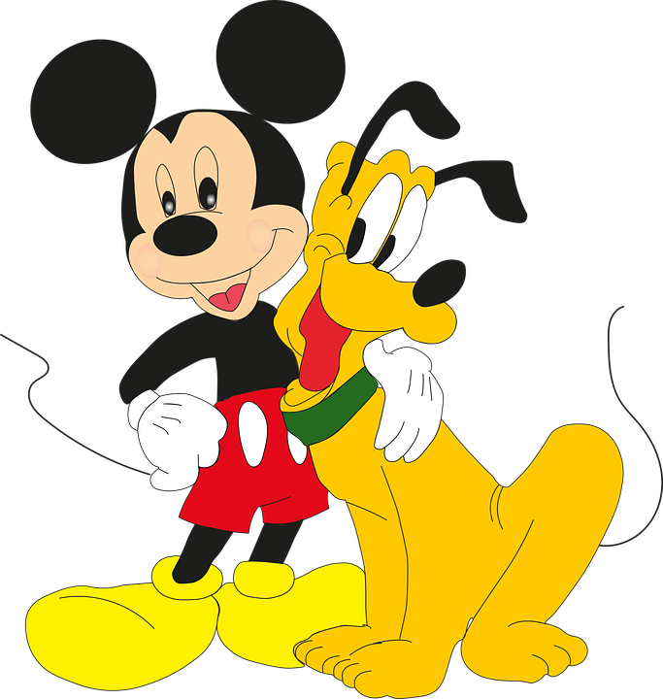
ABOUT ME….
THIS IS MY 27TH YEAR OF TEACHING, ALL OF IT IN PERTH AMBOY - 9 YEARS AT MCGINNIS AND 18 YEARS HERE AT THE HIGH SCHOOL
I HAVE TAUGHT BIOLOGY, ENVIRONMENTAL SCIENCE, AP BIOLOGY AND AP ENVIRONMENTAL SCIENCE (and a few other things)

Slide 3
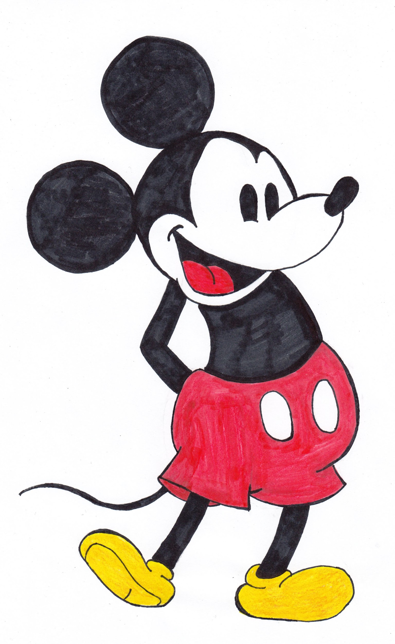
CONTACT INFORMATION
PLEASE FEEL FREE TO EMAIL ME AT markniebojeski@paps.net OR YOU MAY CALL ME AT 732-535-7908 AND LEAVE A MESSAGE.

Slide 4
Biology class:
As an Honors Biology Class, this class will be covering a wide variety of topics at great depth.
Assignments will be conducted in small groups and individually. Even on line, there will be small group collaborative work with students going into a teacher monitored breakout meet room.

Slide 5
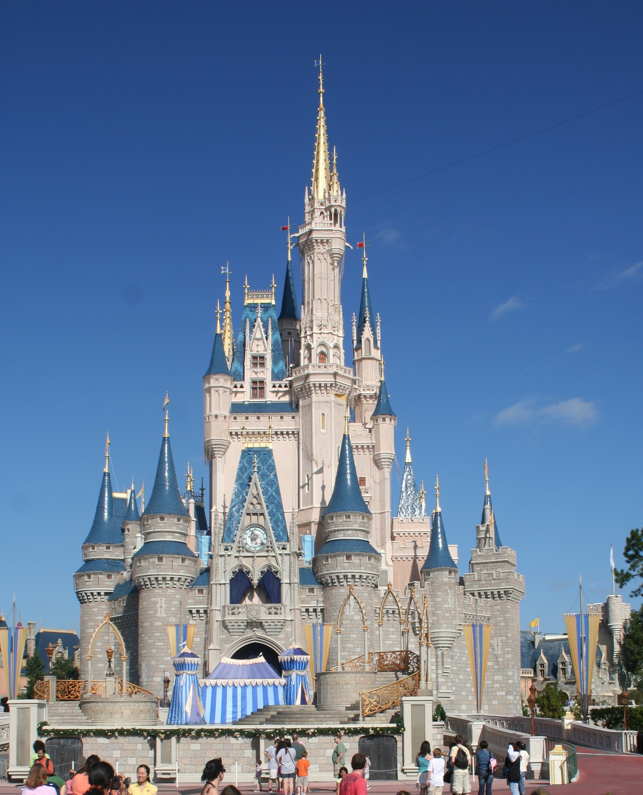
Grading
As per the school guidelines
Formal and Informal assessment (Unit Tests, Mini-tests [quiz], and Lab reports) - 60%
Classwork - 35%
Homework - 5%

Slide 6
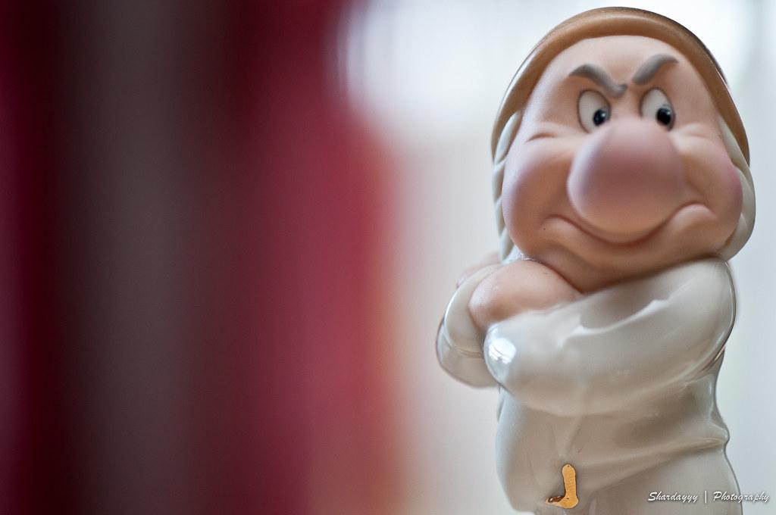
One last thing….
You may have noticed the little images in this presentation….
I am just a big kid at heart who LOVES all things Disney. I strive to keep a lighthearted mood in my class. My classroom is my home and my students are part of my family. I want your children to feel warm and welcome in my school home.
You can learn a lot more with smiles and laughter than by being grumpy

